Slide 1


Project bitBucker
Pritish Samal
Sanjog Panda
Atulananda Panigrahy

Slide 2


Application
Mechanism-
The webpage takes in the user's salary, and the record of his expenditure over a month and warns him whenever the expenditure limit is reached.
1st App
2nd App
A quiz application which tests an individual's finance knowledge through a small quiz and advices him based on his performance.
A tracking application that tracks the money lent by an individual and provides the option to redirect the user to the phonebook in order to call the borrower.
Webpage contains-
Link For Mobile Application to download
Input
USER’s Salary
To the webpage

Slide 3






Project bitBucker
Goal:
The project aims at tracking personal finance of our users by our services , through the package of web and applications we ensure that the money earnt is scrutinized before overspending.
Tools used-
Project comprised of a webpage and two mobile applications.
The webpage is designed using basic html, CSS, Js and bootstrap.
The applications are using kotlin, xml, SQL and material design class to enhances the User Interface

Slide 4
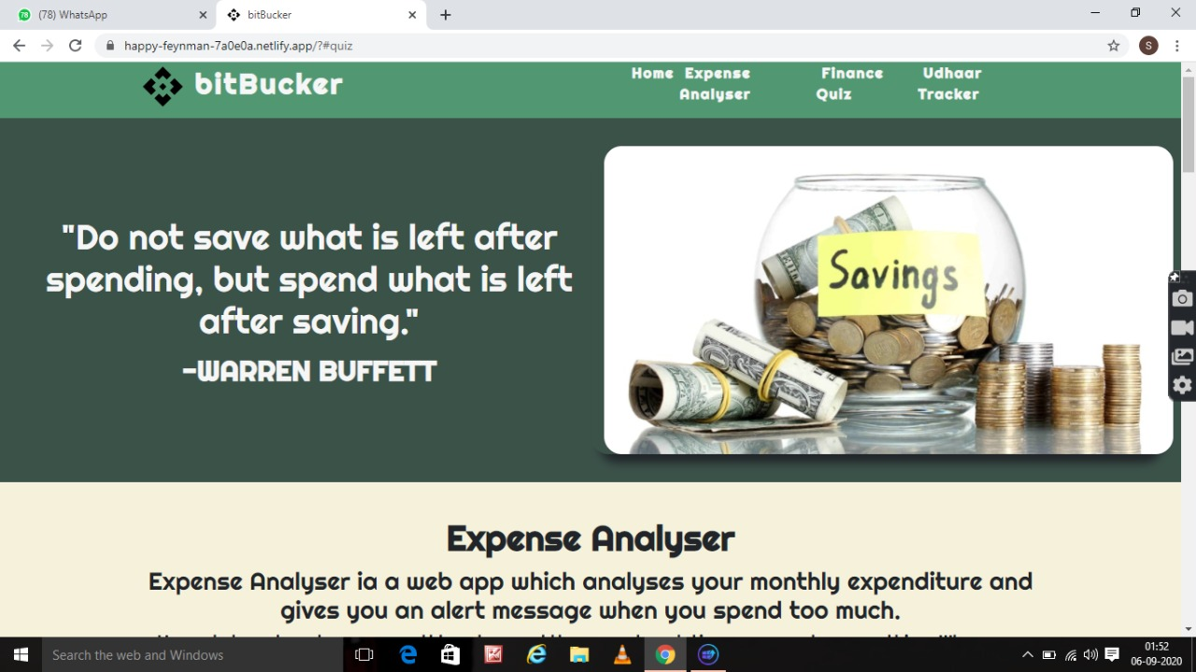
Website Snapshot

Slide 5
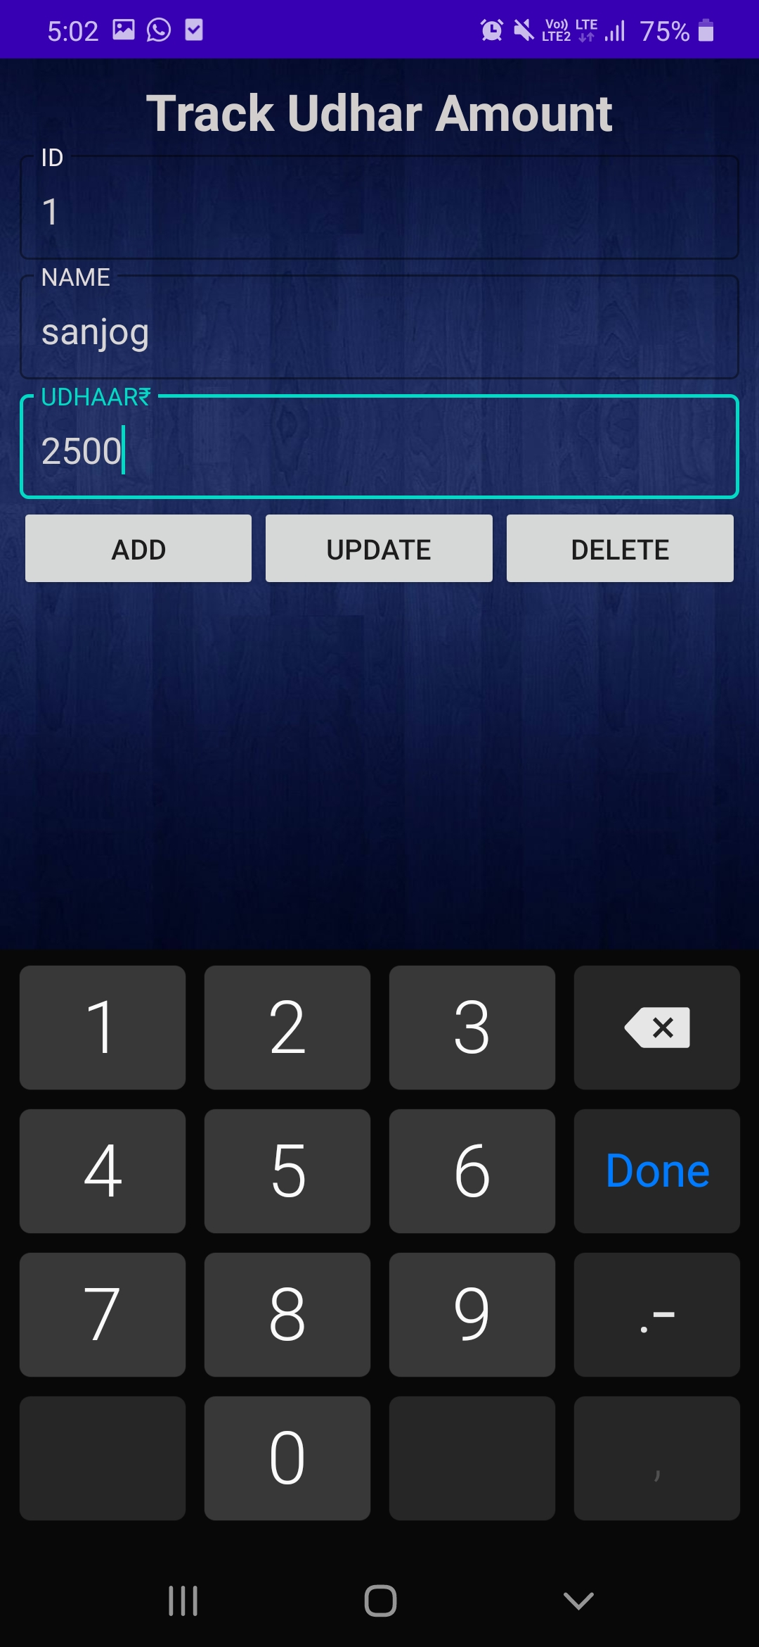
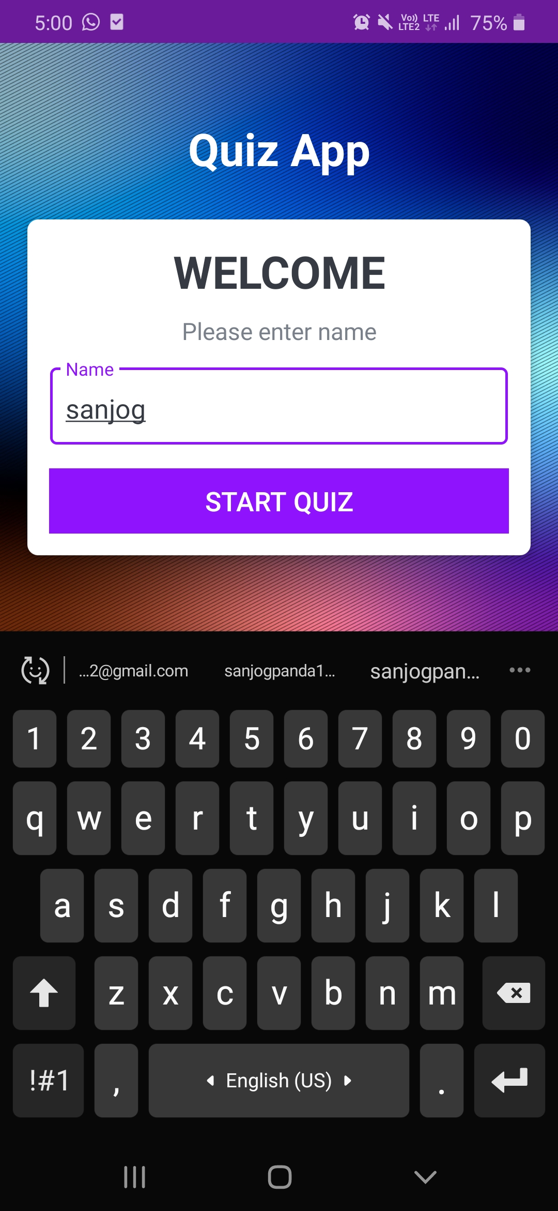
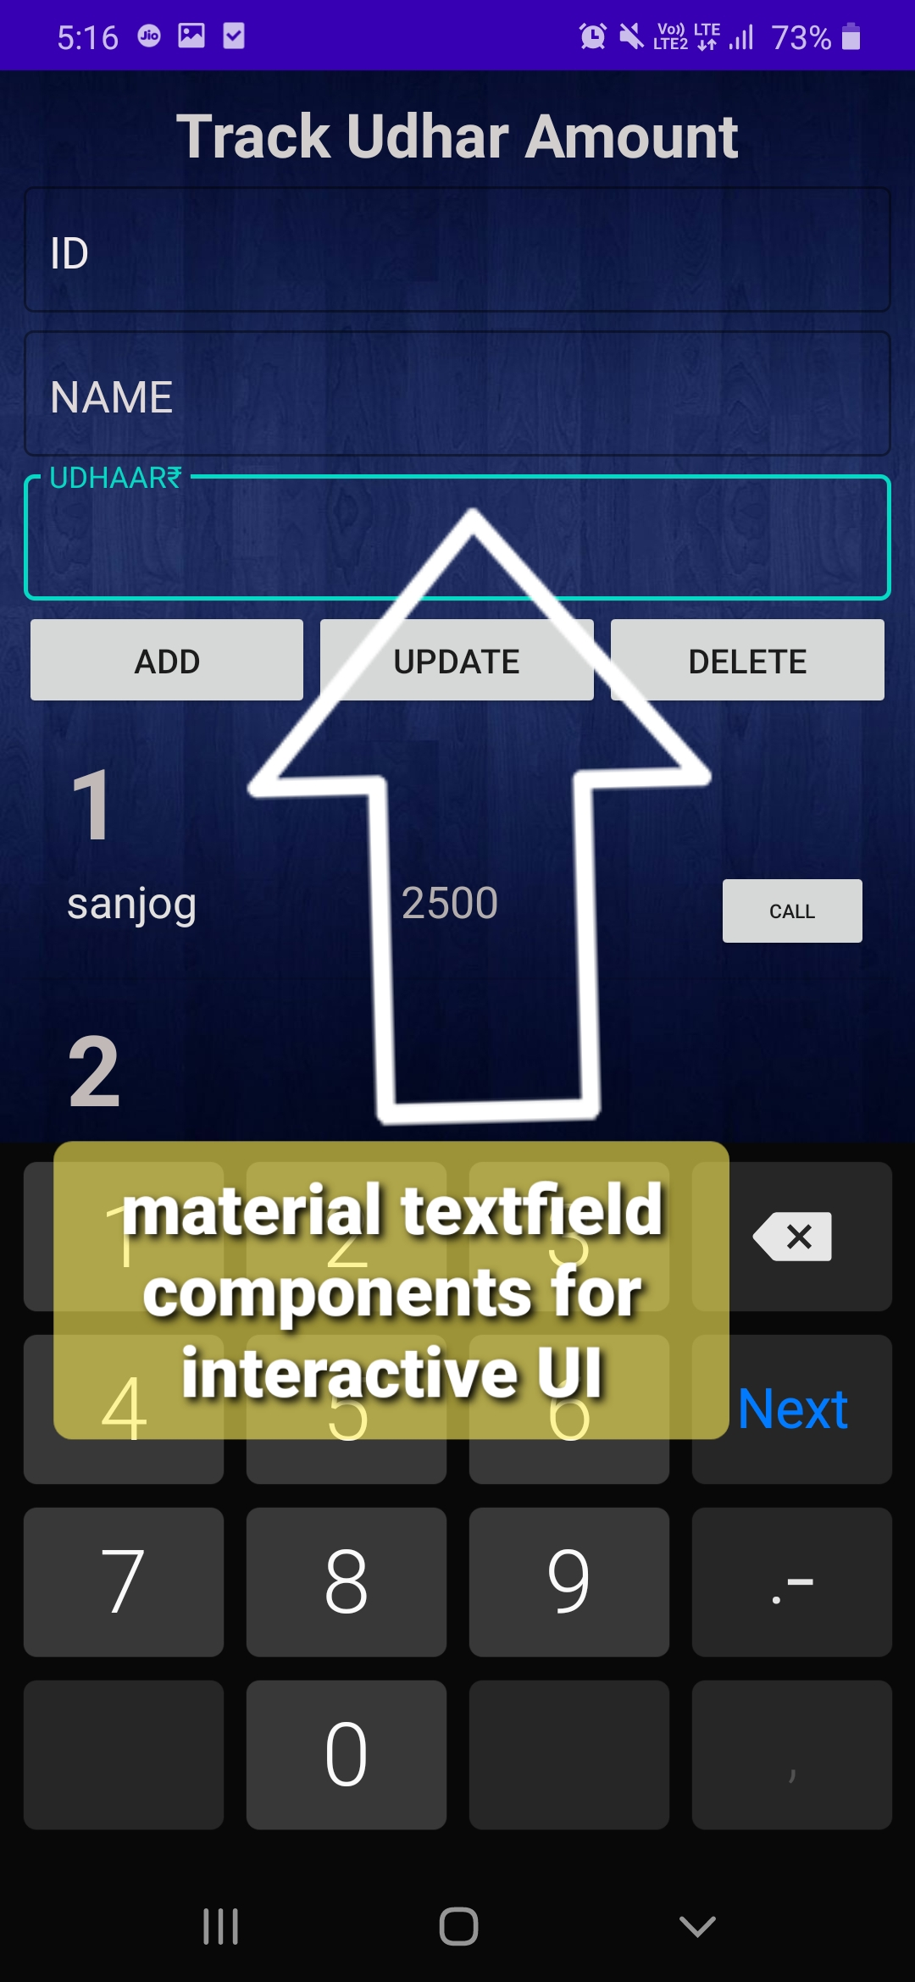
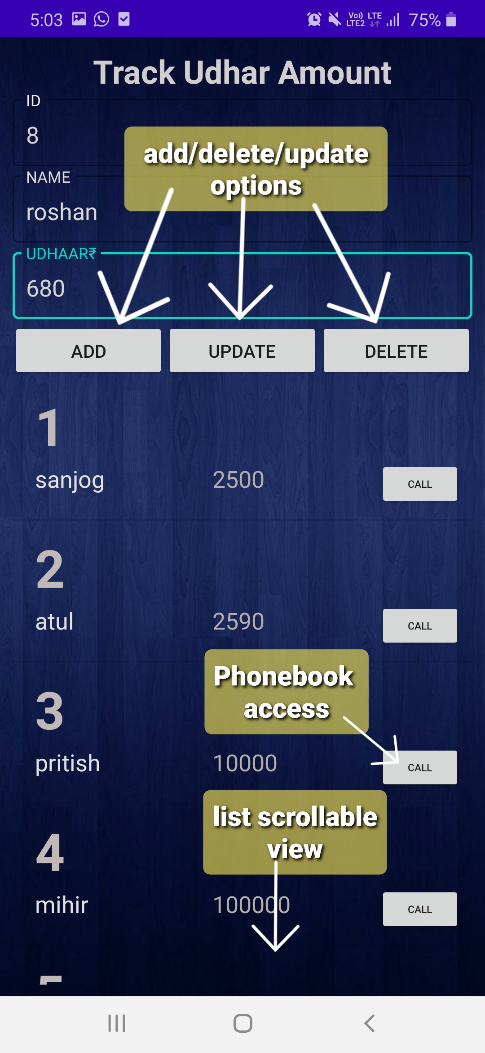
Guide to 1st App-
Simple Interface for Personalized name and amount Insertion and data retrieval

Slide 6
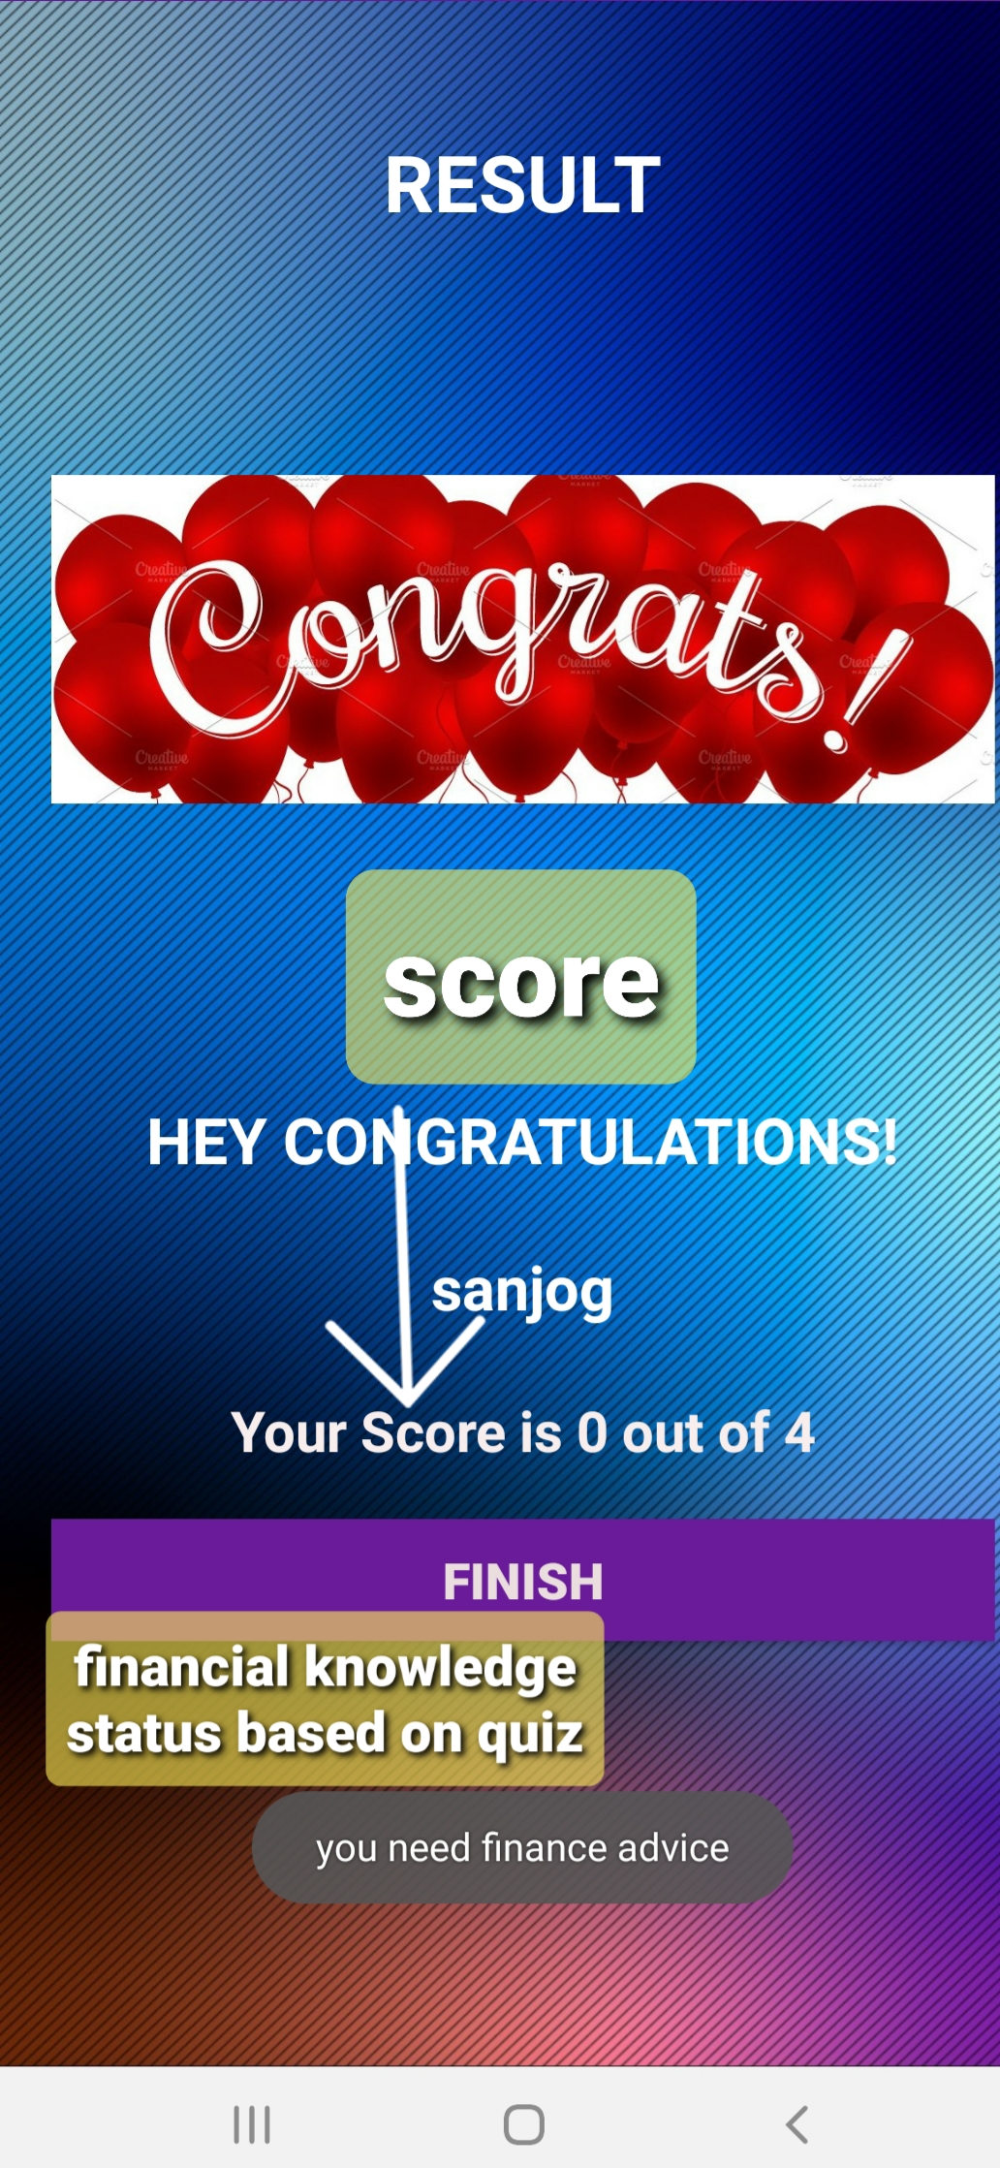
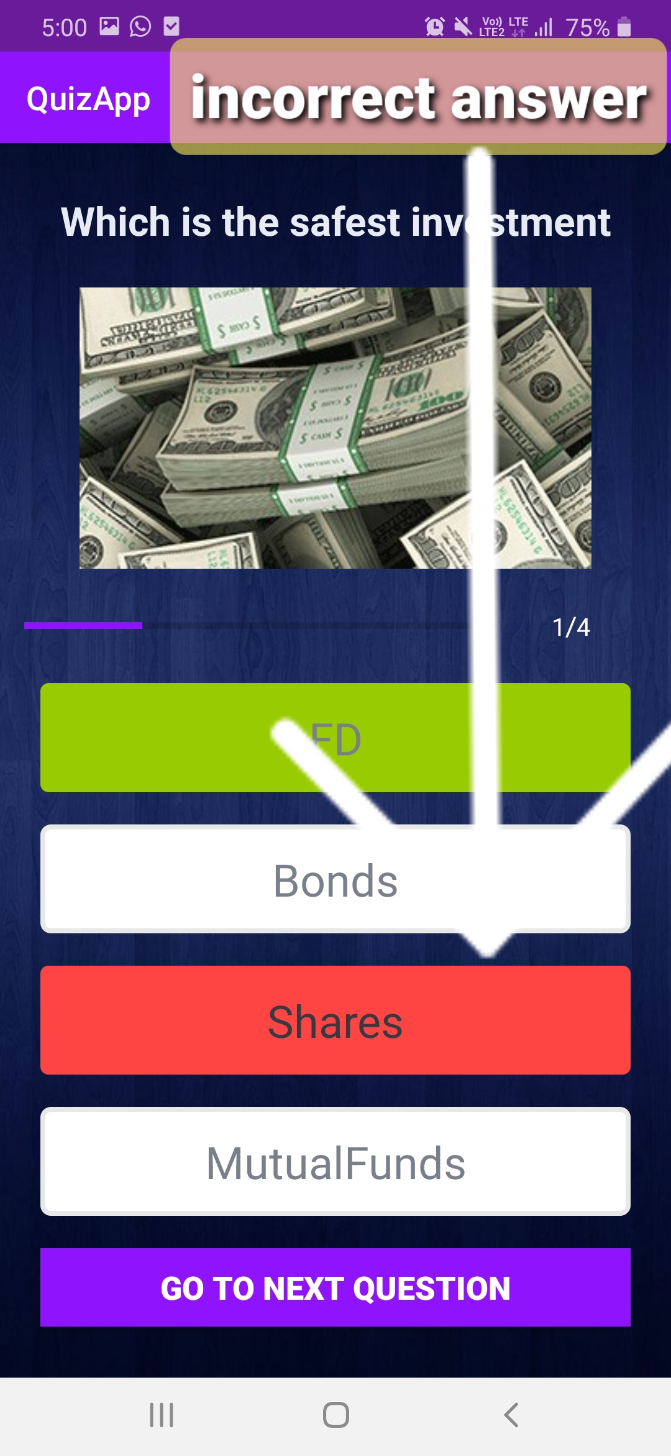
Guide to 2nd App-
Select Answer from multiple Choices
Get Instant result and Score

